Slide 1

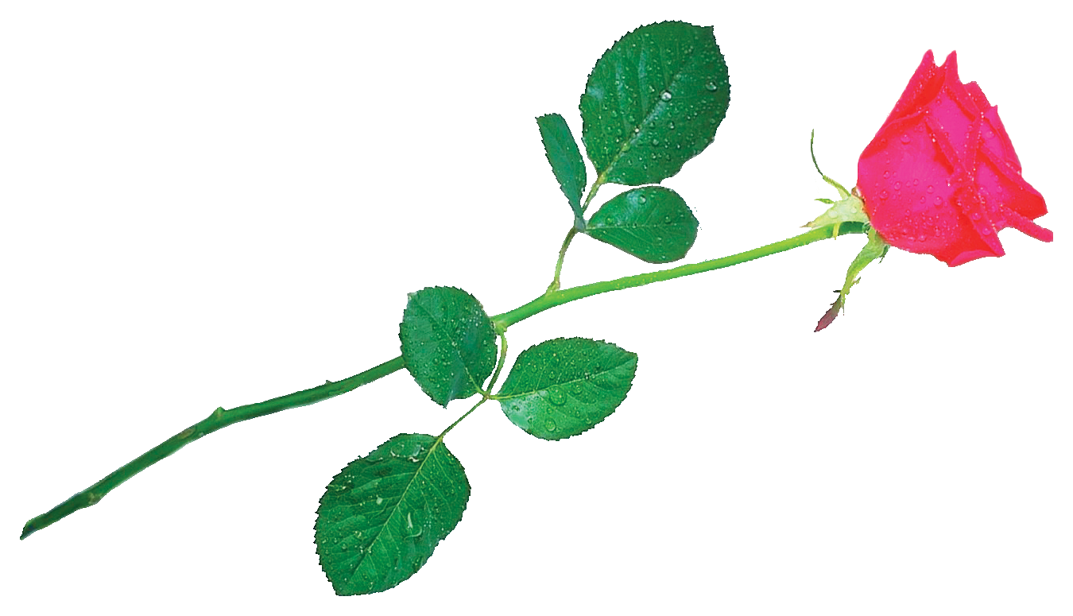
SAVE THE DATE
27 June – 1 July 2027 • Mérida, Mexico

